Slide 1
modal
Taught by Yossef Ayman Zedan

Slide 2
Overview
Use Bootstrap’s JavaScript modal plugin to add dialogs to your site for lightboxes, user notifications, or completely custom content.
Modals are built with HTML, CSS, and JavaScript. They’re positioned over everything else in the document and remove scroll from the <body> so that modal content scrolls instead.
Clicking on the modal “backdrop” will automatically close the modal.
Bootstrap only supports one modal window at a time. Nested modals aren’t supported as we believe them to be poor user experiences.
Modals use position: fixed, which can sometimes be a bit particular about its rendering. Whenever possible, place your modal HTML in a top-level position to avoid potential interference from other elements. You’ll likely run into issues when nesting a .modal within another fixed element.

Slide 3
Modal components
<div class="modal">
<div class="modal-dialog">
<div class="modal-content">
<div class="modal-header">
<h5 class="modal-title">Modal title</h5>
<button type="button" class="btn-close" data-bs-dismiss="modal"></button>
</div>
<div class="modal-body">
<p>Modal body text goes here.</p>
</div>
<div class="modal-footer">
<button type="button" class="btn btn-secondary" data-bs-dismiss="modal">Close</button>
<button type="button" class="btn btn-primary">Save changes</button>
</div>
</div>
</div>
</div>

Slide 4
Example
<!-- Button trigger modal -->
<button type="button" class="btn btn-primary" data-bs-toggle="modal" data-bs-target="#exampleModal">
Launch demo modal
</button>
<!-- Modal -->
<div class="modal fade" id="exampleModal" tabindex="-1" >
<div class="modal-dialog">
<div class="modal-content">
<div class="modal-header">
<h5 class="modal-title" id="exampleModalLabel">Modal title</h5>
<button type="button" class="btn-close" data-bs-dismiss="modal"></button>
</div>

Slide 5
Example
<div class="modal-body">
...
</div>
<div class="modal-footer">
<button type="button" class="btn btn-secondary" data-bs-dismiss="modal">Close</button>
<button type="button" class="btn btn-primary">Save changes</button>
</div>
</div>
</div>
</div>

Slide 6
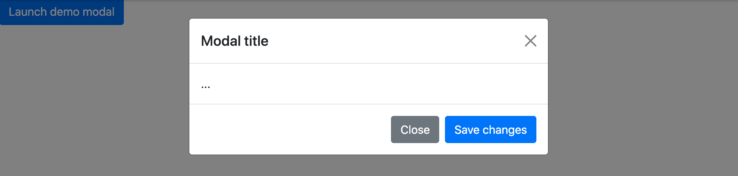
Example

Slide 7
Static backdrop
When backdrop is set to static, the modal will not close when clicking outside it.
<div class="modal fade" id="staticBackdrop" data-bs-backdrop="static" data-bs-keyboard="false"> </div>

Slide 8
Scrolling long content
When modals become too long for the user’s viewport or device, they scroll independent of the page itself.
You can also create a scrollable modal that allows scroll the modal body by adding .modal-dialog-scrollable to .modal-dialog.
<div class="modal-dialog modal-dialog-scrollable"> </div>

Slide 9
Vertically centered
Add .modal-dialog-centered to .modal-dialog to vertically center the modal.
<!-- Vertically centered modal -->
<div class="modal-dialog modal-dialog-centered">
...
</div>
<!-- Vertically centered scrollable modal -->
<div class="modal-dialog modal-dialog-centered modal-dialog-scrollable">
...
</div>

Slide 10
Tooltips and popovers
Tooltips and popovers can be placed within modals as needed. When modals are closed, any tooltips and popovers within are also automatically dismissed.
<div class="modal-body">
<h5>Popover in a modal</h5>
<p>This <a href="#" role="button" class="btn btn-secondary popover-test" title="Popover title" data-bs-content="Popover body content is set in this attribute.">button</a> triggers a popover on click.</p>
<hr>
<h5>Tooltips in a modal</h5>
<p><a href="#" class="tooltip-test" title="Tooltip">This link</a> and <a href="#" class="tooltip-test" title="Tooltip">that link</a> have tooltips on hover.</p>
</div>

Slide 11
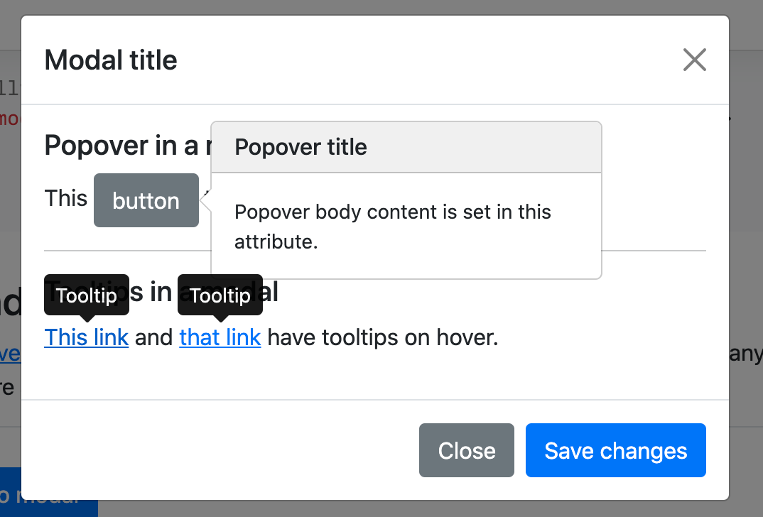
Tooltips and popovers

Slide 12
Using the grid
<div class="modal-body">
<div class="container-fluid">
<div class="row">
<div class="col-md-4">.col-md-4</div>
<div class="col-md-4 ms-auto">.col-md-4 .ms-auto</div>
</div>
<div class="row">
<div class="col-md-3 ms-auto">.col-md-3 .ms-auto</div>
<div class="col-md-2 ms-auto">.col-md-2 .ms-auto</div>
</div>
<div class="row">
<div class="col-md-6 ms-auto">.col-md-6 .ms-auto</div>
</div>
<div class="row">
<div class="col-sm-9">
Level 1: .col-sm-9
<div class="row">

Slide 13
Using the grid
<div class="col-8 col-sm-6">
Level 2: .col-8 .col-sm-6
</div>
<div class="col-4 col-sm-6">
Level 2: .col-4 .col-sm-6
</div>
</div>
</div>
</div>
</div>
</div>

Slide 14
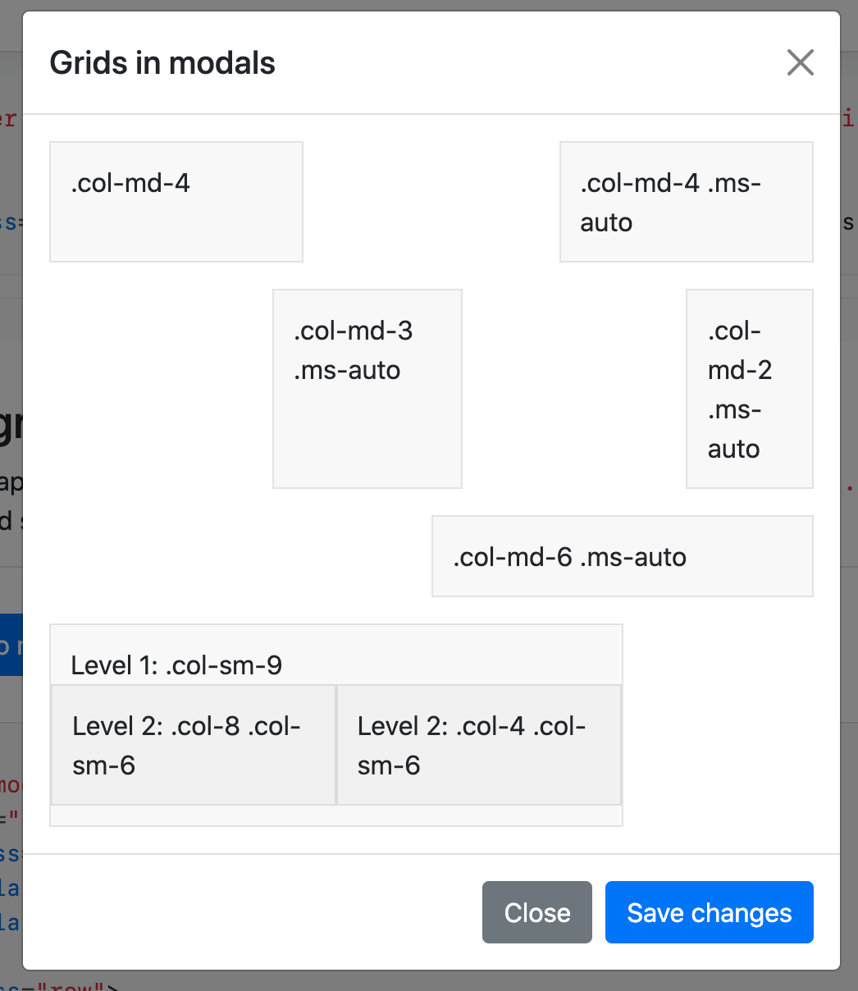
Using the grid

Slide 15
Using the grid
<button type="button" class="btn btn-primary" data-bs-toggle="modal" data-bs-target="#exampleModal" data-bs-whatever="@mdo">Open modal for @mdo</button>
<button type="button" class="btn btn-primary" data-bs-toggle="modal" data-bs-target="#exampleModal" data-bs-whatever="@fat">Open modal for @fat</button>
<button type="button" class="btn btn-primary" data-bs-toggle="modal" data-bs-target="#exampleModal" data-bs-whatever="@getbootstrap">Open modal for @getbootstrap</button>
<div class="modal fade" id="exampleModal" tabindex="-1" aria-labelledby="exampleModalLabel" aria-hidden="true">
<div class="modal-dialog">
<div class="modal-content">
<div class="modal-header">
<h5 class="modal-title" id="exampleModalLabel">New message</h5>
<button type="button" class="btn-close" data-bs-dismiss="modal" aria-label="Close"></button>
</div>

Slide 16
Using the grid
<div class="modal-body">
<form>
<div class="mb-3">
<label for="recipient-name" class="col-form-label">Recipient:</label>
<input type="text" class="form-control" id="recipient-name">
</div>
<div class="mb-3">
<label for="message-text" class="col-form-label">Message:</label>
<textarea class="form-control" id="message-text"></textarea>
</div>
</form>
</div>

Slide 17
Using the grid
<div class="modal-footer">
<button type="button" class="btn btn-secondary" data-bs-dismiss="modal">Close</button>
<button type="button" class="btn btn-primary">Send message</button>
</div>
</div>
</div>
</div>

Slide 18
Using the grid | JavaScript
var exampleModal = document.getElementById('exampleModal')
exampleModal.addEventListener('show.bs.modal', function (event) {
// Button that triggered the modal
var button = event.relatedTarget
// Extract info from data-bs-* attributes
var recipient = button.getAttribute('data-bs-whatever')
// If necessary, you could initiate an AJAX request here
// and then do the updating in a callback.
//
// Update the modal's content.
var modalTitle = exampleModal.querySelector('.modal-title')
var modalBodyInput = exampleModal.querySelector('.modal-body input')
modalTitle.textContent = 'New message to ' + recipient
modalBodyInput.value = recipient
})

Slide 19
Toggle between modals
Toggle between multiple modals with some clever placement of the data-bs-target and data-bs-toggle attributes. For example, you could toggle a password reset modal from within an already open sign in modal. Please note multiple modals cannot be open at the same time—this method simply toggles between two separate modals.

Slide 20
Toggle between modals
<div class="modal fade" id="exampleModalToggle”>
<div class="modal-dialog modal-dialog-centered">
<div class="modal-content">
<div class="modal-header">
<h5 class="modal-title" id="exampleModalToggleLabel">Modal 1</h5>
<button type="button" class="btn-close" data-bs-dismiss="modal" aria-label="Close"></button>
</div>
<div class="modal-body">
Show a second modal and hide this one with the button below.
</div>
<div class="modal-footer">
<button class="btn btn-primary" data-bs-target="#exampleModalToggle2" data-bs-toggle="modal" data-bs-dismiss="modal">Open second modal</button>
</div>
</div>
</div>
</div>

Slide 21
Toggle between modals
<div class="modal fade" id="exampleModalToggle2”>
<div class="modal-dialog modal-dialog-centered">
<div class="modal-content">
<div class="modal-header">
<h5 class="modal-title" id="exampleModalToggleLabel2">Modal 2</h5>
<button type="button" class="btn-close" data-bs-dismiss="modal" aria-label="Close"></button>
</div>
<div class="modal-body">
Hide this modal and show the first with the button below.
</div>
<div class="modal-footer">
<button class="btn btn-primary" data-bs-target="#exampleModalToggle" data-bs-toggle="modal" data-bs-dismiss="modal">Back to first</button>
</div>
</div>
</div>
</div>
<a class="btn btn-primary" data-bs-toggle="modal" href="#exampleModalToggle" role="button">Open first modal</a>

Slide 22
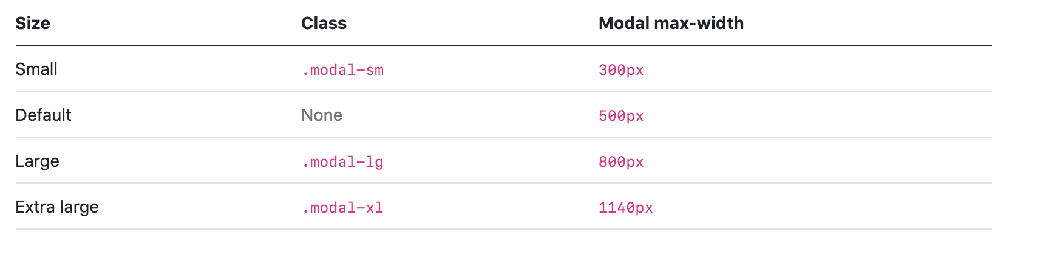
Optional sizes
Modals have three optional sizes, available via modifier classes to be placed on a .modal-dialog. These sizes kick in at certain breakpoints to avoid horizontal scrollbars on narrower viewports.

Slide 23
Optional sizes
<div class="modal-dialog modal-xl">...</div>
<div class="modal-dialog modal-lg">...</div>
<div class="modal-dialog modal-sm">...</div>

Slide 24
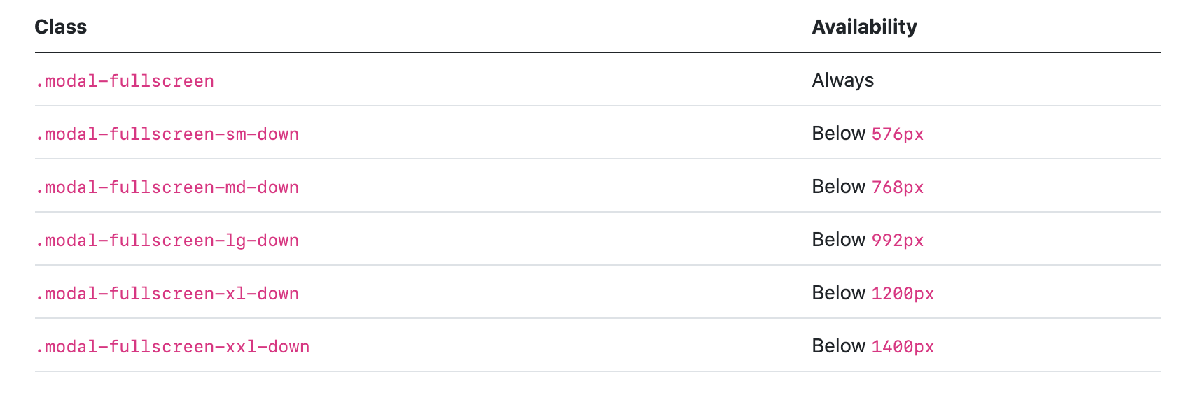
Fullscreen Modal
Another override is the option to pop up a modal that covers the user viewport, available via modifier classes that are placed on a .modal-dialog.

Slide 25
Fullscreen Modal
<!-- Full screen modal -->
<div class="modal-dialog modal-fullscreen-sm-down">
...
</div>. ..

Slide 26
Remove animation
For modals that simply appear rather than fade in to view, remove the .fade class from your modal markup.
<div class="modal”>
</div>

